Slide 1

Chapter 5
States of Consciousness
© 2020 McGraw-Hill Education. All rights reserved. Authorized only for instructor use in the classroom. No reproduction or further distribution permitted without the prior written consent of McGraw-Hill Education
Notes:
Photo credit: © Jamie Grill/JGI/Getty Images

Slide 2
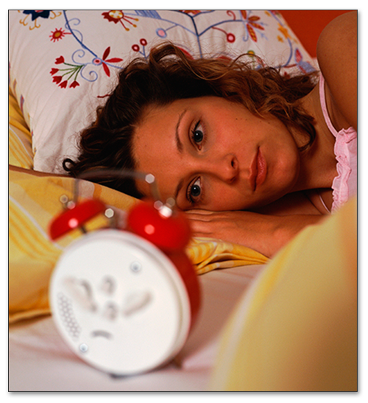
The Nature of Consciousness (1)
What is consciousness?
Awareness
    Knowledge of external events and internal sensations
    Arousal
      ways that awareness is regulated:
        alert versus drowsy
Notes:
What is Consciousness? It might be interesting to pose this question to students and have them discuss/debate the nature of consciousness prior to discussing the topic in class. For example, students might discuss how they know they are conscious and how they could convince others that they are conscious.

Slide 3
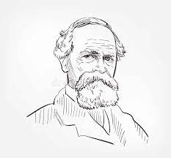
Early Research
William James
Stream-of-consciousness
  Used to describe how thoughts flow through the mind
    Continuous flow of changing sensations, thoughts, images, and feelings
  Full range of thoughts one can be aware of
  Also includes thoughts and feelings we have about our thoughts and feelings

Slide 4
The Nature of Consciousness (2)
Conscious awareness represents our private, inner mind
  Thinking
  Memories
  Emotions
  Planning
  Imagination

Slide 5
Theory of Mind
Knowledge that other People Think and Have Private Experiences
Different people have different subjective experiences
Develops during childhood; fully formed by adolescence
Sally-Anne Test: Do we assume others have the same viewpoint as us?

Slide 6
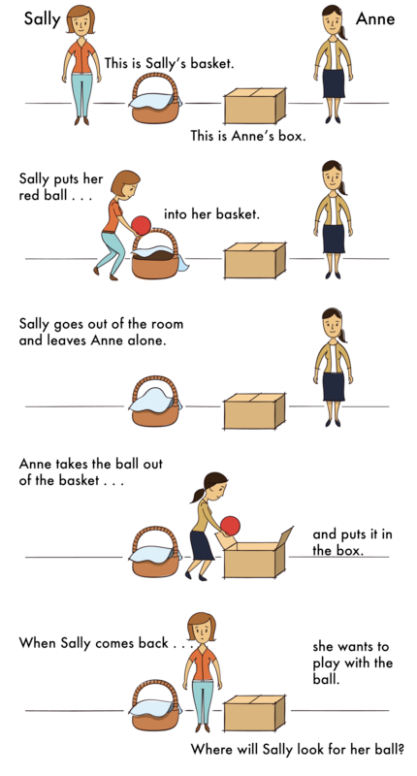

Slide 7
Higher Level Awareness (1)
Controlled Processes
  Attention/efforts are actively directed towards a goal
Executive functions are key to controlled processes
  Higher order cognitive processes: Thinking, planning, and problem solving

Slide 8
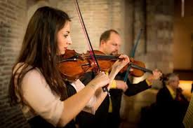
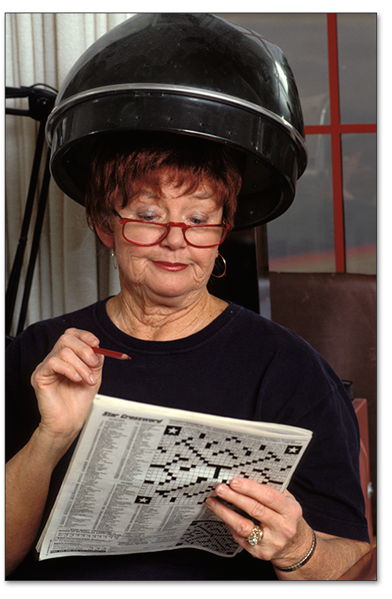

Higher Level Awareness (2)
Higher-Level Consciousness
Photo credit: Ingram Publishing
Notes:
Note: Control processes are managed by the prefrontal cortex

Slide 9
Lower Level Awareness (1)
Automatic Processes
  Require little attention and don’t interfere with other ongoing activities
  “going on autopilot”
  Higher-level processes can become automatic over time with practice
    Example: Driving
  Still conscious, just less so than higher level processes
    Require less attention

Slide 10

Lower Level Awareness (2)
Other Examples:
  Daydreaming
    wandering thoughts
    fantasy, imagination
    potentially useful (reminding, solving)

Slide 11
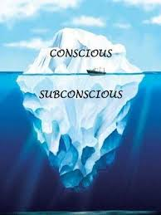
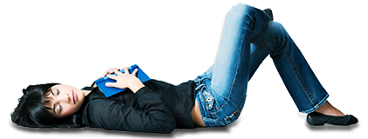
Levels of Awareness (1)
Subconscious Awareness
  Just below the surface
Sleep and Dreams
  low levels of consciousness of outside world
No Awareness
  Unconscious thought—Freud
  non-conscious processes
Notes:
Possibility: The levels of awareness on this slide are on a continuum with the “lower-level” consciousness covered on the slide before the preceding slide about altered states. You may want to move this slide forward to maintain that continuity. Otherwise, the slides will follow the sequence found in the textbook.

Slide 12
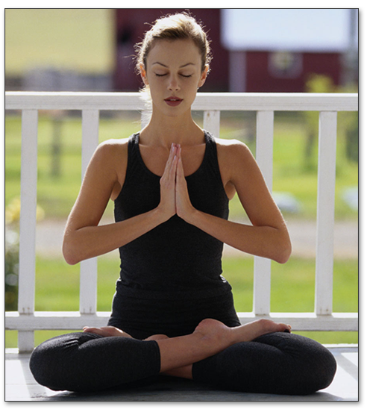
Levels of Awareness (2)
Altered States of Consciousness
  drug states
  fatigue, illness, trauma, deprivation
  meditation, hypnosis
  mental disorders
Photo credit: © Jules Frazier/Getty Images RF

Slide 13
Subconscious States
Sleep and dreams
Sleeping individuals can still respond to external stimuli
  Respond to faint sounds by pushing a button (Ogilvie & Wilkinson, 1988)
  Areas of the brain related to language show activation when sleeping individuals hear their own name (Stickgold, 2001)

Slide 14
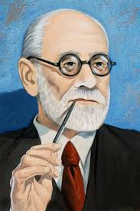
No Awareness
Traditional version:
  Anesthetized, knocked out, etc.
Freud’s version:
  Unconscious thought
  A reservoir of unacceptable wished, feelings, or thoughts beyond conscious awareness

Slide 15
No Awareness
Can a thought really be unconscious???
Does thinking imply some level of conscious awareness?

Slide 16
Freud and the Unconscious
Unconscious thought exists to shield us from our most vile desires and impulses
The conscious mind must keep the unconscious in check
What if we all acted on our first impulses?

Slide 17
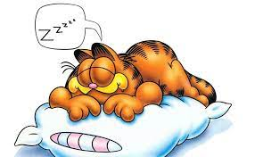
Sleep
A body/mind revert to a subconscious state
Important for our internal, biological rhythms
Example: Fluctuation in body temp

Slide 18
Biological Rhythms
Periodic Physiological Fluctuations
  Annual or seasonal
  24-hour cycles = circadian rhythms
    monitored by suprachiasmatic nucleus
    controlled by biological clocks
Notes:
Suggestion: Have students suggest annual and seasonal rhythms found in other species. Some examples they may come up with include shedding and going into heat.
Note: Circadian rhythms include eating and elimination cycles as well as sleep cycles. The fact that eating cycles include multiple meals, and some culture’s sleep cycle include a siesta, does not negate the over-all cycle’s daily rhythm.

Slide 19

Sleep
Suprachiasmatic nucleus (SCN) – Monitors the change from day to night
  Takes input from the retina and synchronizes the body’s routines with day/night cycle
Critical for regulating circadian rhythm!

Slide 20
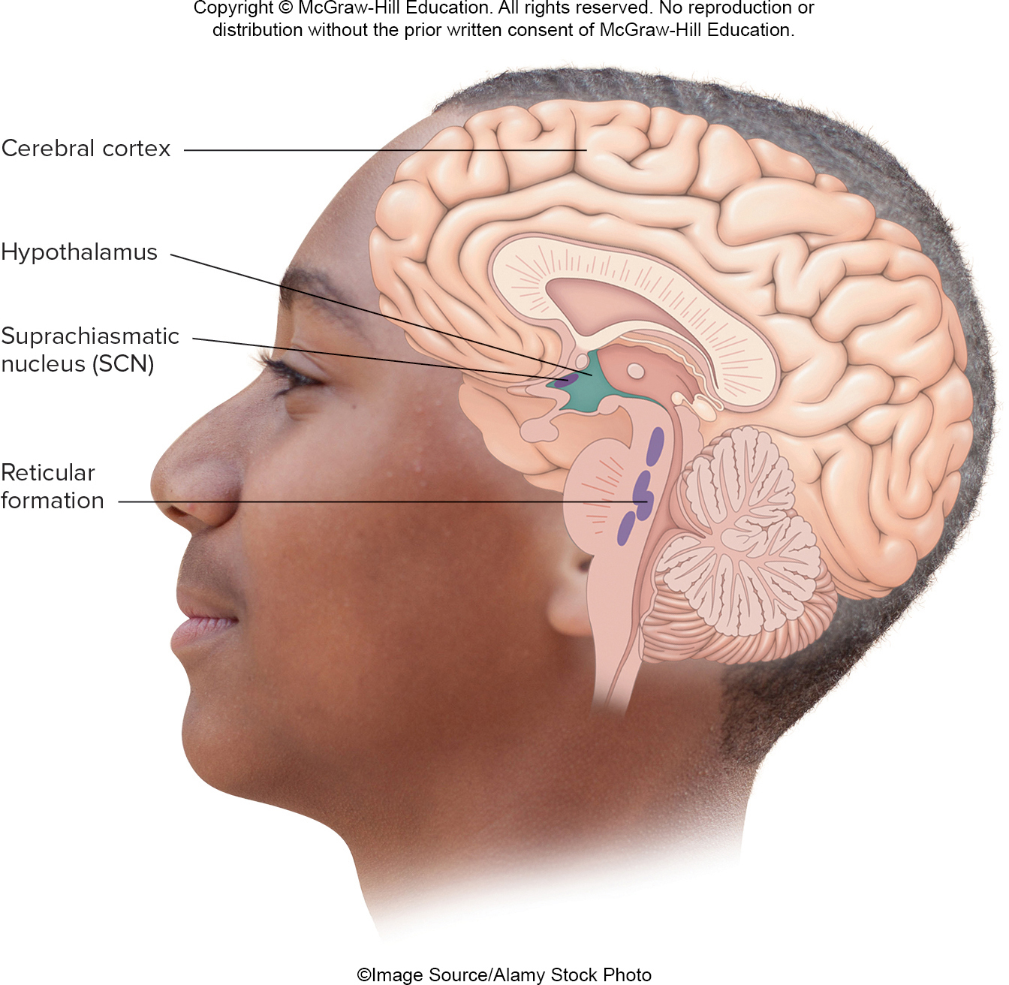
Notes:
Suggestion: Have students suggest annual and seasonal rhythms found in other species. Some examples they may come up with include shedding and going into heat.
Note: Circadian rhythms include eating and elimination cycles as well as sleep cycles. The fact that eating cycles include multiple meals, and some culture’s sleep cycle include a siesta, does not negate the over-all cycle’s daily rhythm.

Slide 21
Biological Rhythms
Not unique to humans!
Other examples?
Notes:
Suggestion: Have students suggest annual and seasonal rhythms found in other species. Some examples they may come up with include shedding and going into heat.
Note: Circadian rhythms include eating and elimination cycles as well as sleep cycles. The fact that eating cycles include multiple meals, and some culture’s sleep cycle include a siesta, does not negate the over-all cycle’s daily rhythm.

Slide 22
Desynchronizing the Biological Clock
Jet Lag
  Fly from Wichita Falls → Hawaii (gain 5 hours)
Shift workers
  Switching from night shift to morning shift

Slide 23
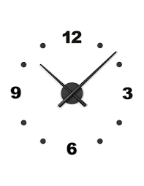

Resetting the Biological Clock
How to reset the clock?
  Bright lights during the day (especially morning)
  Melatonin supplements at night
Caffeine?
  Delays the internal clock
  helpful if you need to stay awake
  Problems?

Slide 24

Why Do We Need Sleep?
Adaptive Evolutionary Function
  Safety
  energy conservation/ efficiency
Restorative Function
  body rejuvenation & growth
Brain Plasticity
  enhances synaptic connections
  memory consolidation
Notes:
Suggestion: Ask class what problems could arise attempting to hunt or gather food at night instead of sleeping. Tie in to survival advantage.

Slide 25
Chronic Sleep Deprivation (1)
Is 8 hours sufficient?
  Optimal amount varies from person to person
    Infants: 14-17 hours (3 hours sleep, 1 hour awake, repeat)
    Average adult: 7-9 hours (hopefully continuous…)
  Level of activity is also important!
    More activity during day == greater need for sleep!

Slide 26
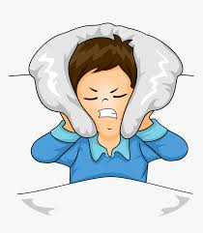
Chronic Sleep Deprivation (2)
Sleep deprivation causes extra activity in the thalamus and PFC
  Thalamus == sensory perception
  PFC == thinking and planning
Extra activity in these areas means neural pathways are overloaded
  Brain must find additional routes, slowing performance
  Leads to difficulty paying attention, solving problems, and thinking critically

Slide 27
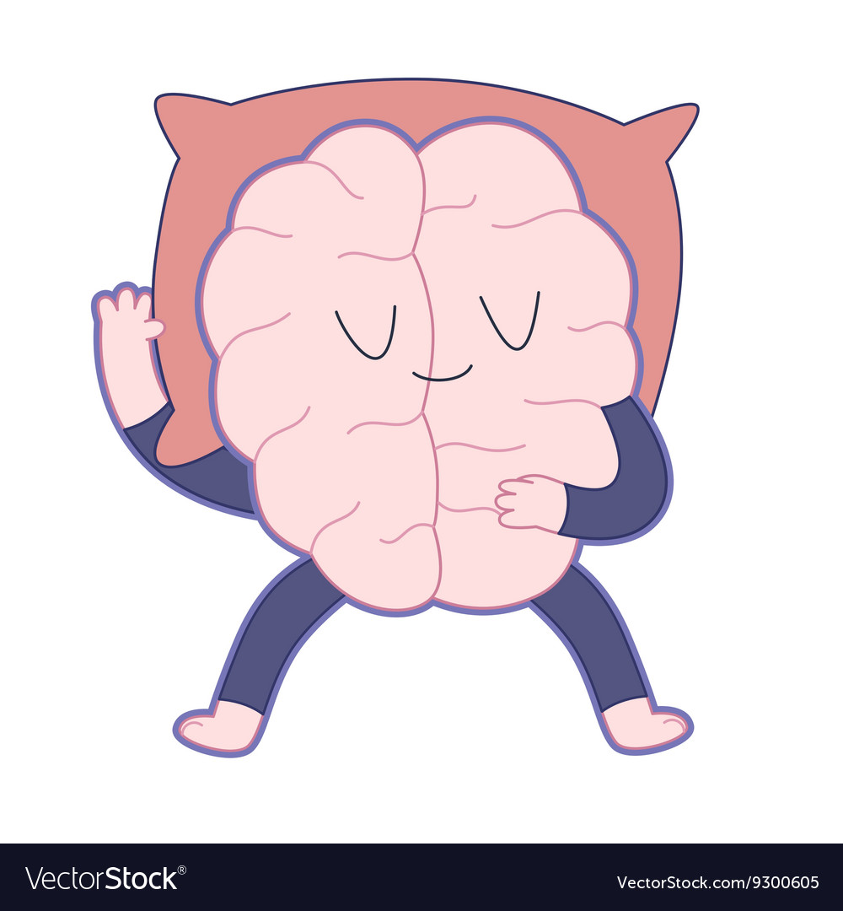
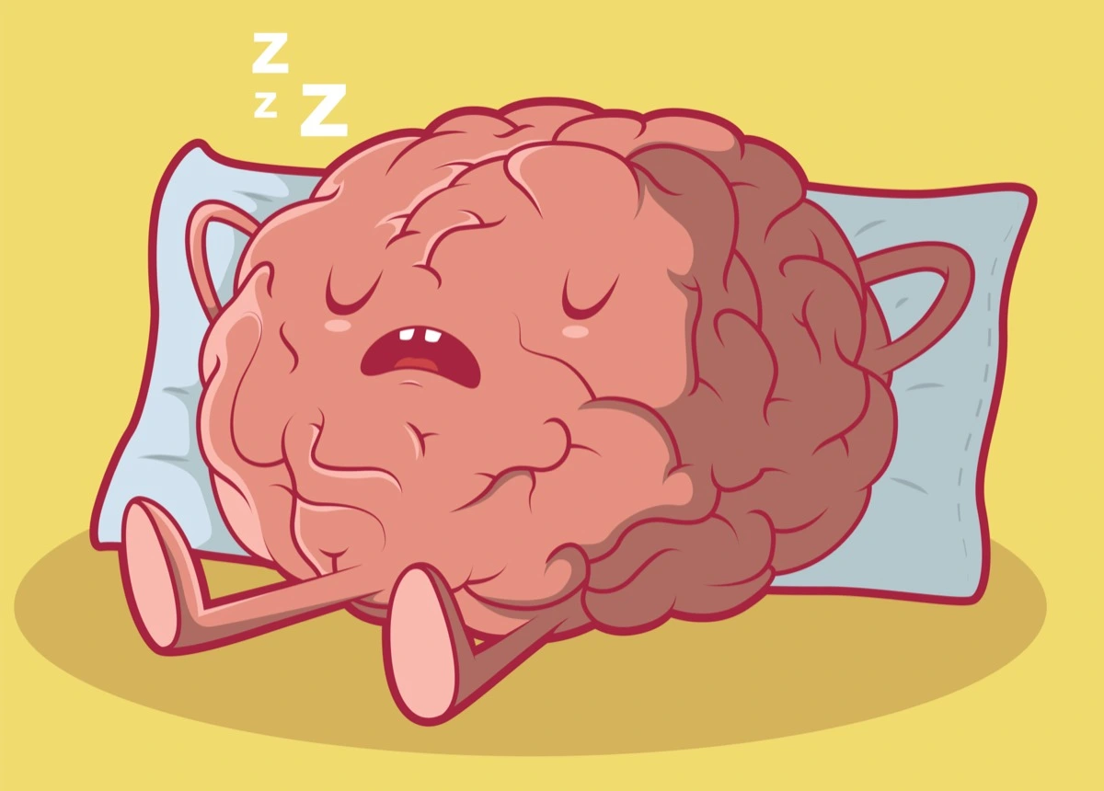
Brain Activity While Sleeping
What happens in the brain while we sleep?
  Can use neuroscience to find out!

Slide 28
Neuroscience Reminder
Goal: Understand the links between behavior and brain activity
Typical sleep study uses EEG to assess changes in brain activity during sleep

Slide 29
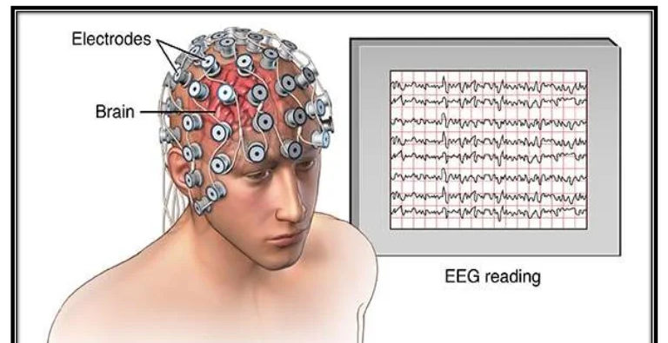
EEG Reminder
Measures brain waves! (Electrical Activity)
Notes:
Note: Brain waves are an aggregation of the electrical activity of thousands of neurons. The reason alert wakefulness is associated with desynchronous brain waves is analogous to the sound produced by a stadium full of fans chatting in separate conversations—each neuron is busily about its own business.

Slide 30
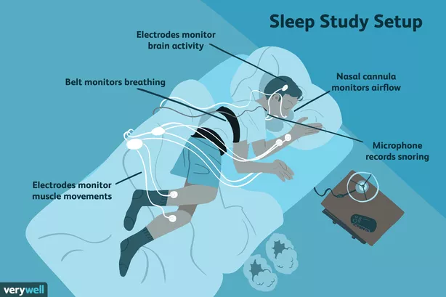
Notes:
Note: Brain waves are an aggregation of the electrical activity of thousands of neurons. The reason alert wakefulness is associated with desynchronous brain waves is analogous to the sound produced by a stadium full of fans chatting in separate conversations—each neuron is busily about its own business.

Slide 31
Brain Activity While Sleeping
EEG measures electrical activity in the brain (Brain waves)
  Patterns of electrical activity undergo cycles of change
  Researchers have identified five distinct stages, based on patterns of activity
Notes:
Note: Brain waves are an aggregation of the electrical activity of thousands of neurons. The reason alert wakefulness is associated with desynchronous brain waves is analogous to the sound produced by a stadium full of fans chatting in separate conversations—each neuron is busily about its own business.

Slide 32
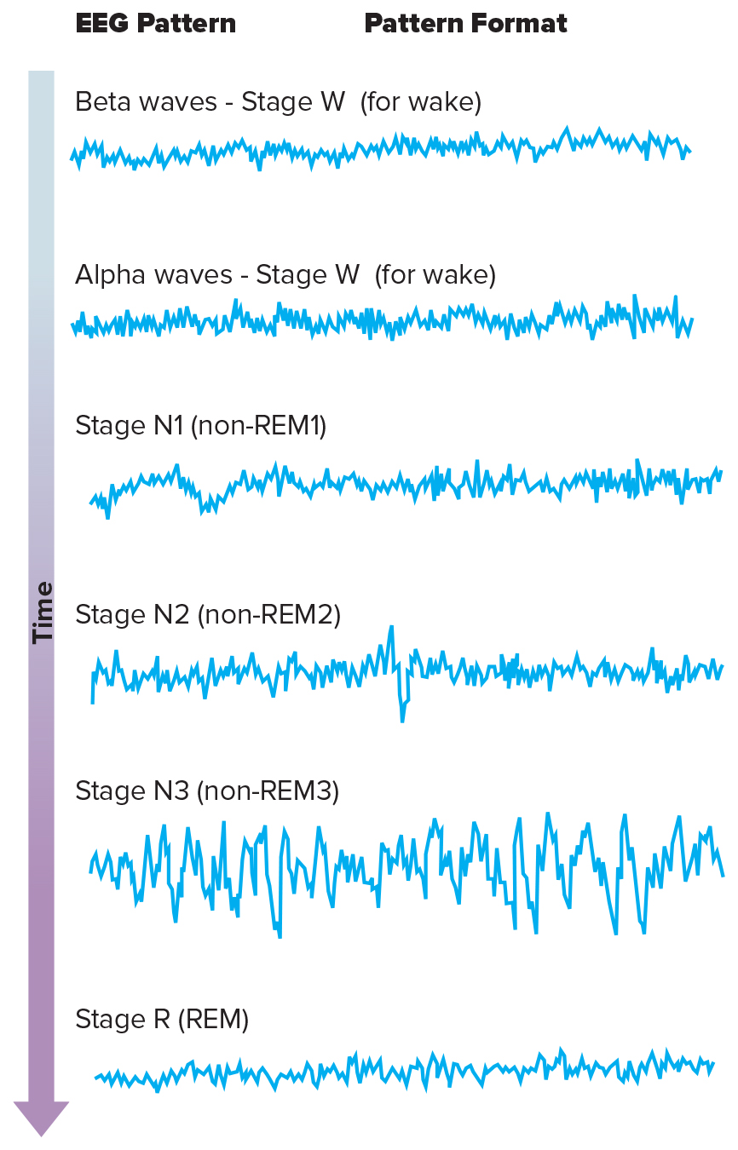
Waking Brain Activity
Wakefulness (Alert)
    beta waves (W-alert)
      high frequency
      low amplitude
      Desynchronous (white noise or static – can’t make out any patterns)

Slide 33
Stages of Sleep (1)
Wakefulness (Relaxed but awake)
  alpha waves (W-relaxed)
    Lower frequency
    Low amplitude (but greater than beta)

Slide 34
Stages of Sleep (2)
Stage W
  Awake Alert
  Awake Relaxed
Stage N1 (Non-REM1) Sleep
Stage N2 (Non-REM2) Sleep
Stage N3 (Non-REM3) Sleep
Stage R (REM) Sleep

Slide 35
Stages of Sleep (3)
Stage N-1
  theta waves
  Even slower frequency
  low amplitude (but greater than alpha)
  Very light sleep (semi-awake state)

Slide 36
Stages of Sleep (4)
Stage N-2
  Continued theta waves, plus:
  sleep spindles: sudden increase in wave frequency
  still light sleep

Slide 37
Stages of Sleep (5)
Stage N-3
  delta waves
  slowest frequency and highest amplitude
  deep sleep
  bedwetting, sleep walking, sleep talking

Slide 38
Stages of Sleep (6)
Stage R (REM Sleep)
Rapid Eye Movements
EEG similar to relaxed wakefulness
dreaming

Slide 40
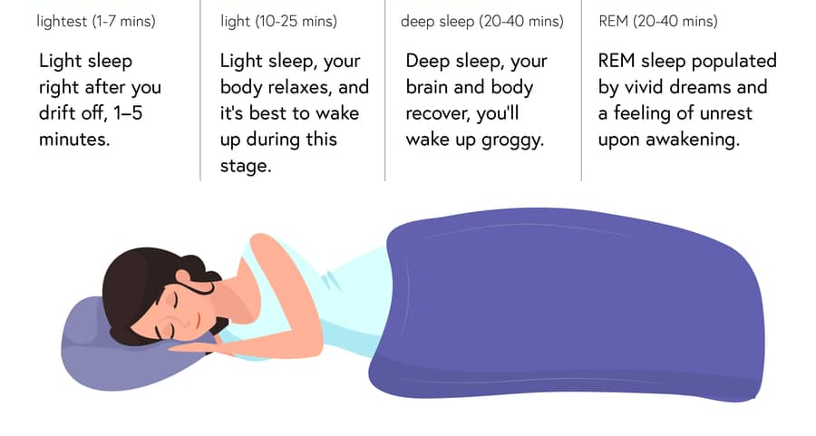
N1
N2
N3
REM

Slide 41
Sleep Cycles
Typically 5 cycles a night
90 to 100 minutes per cycle
Sleep patterns change during the night.
Typical night includes:
  60% - Stages N1 & N2 sleep
  20% - Stage N3 sleep
  20% - REM sleep

Slide 42
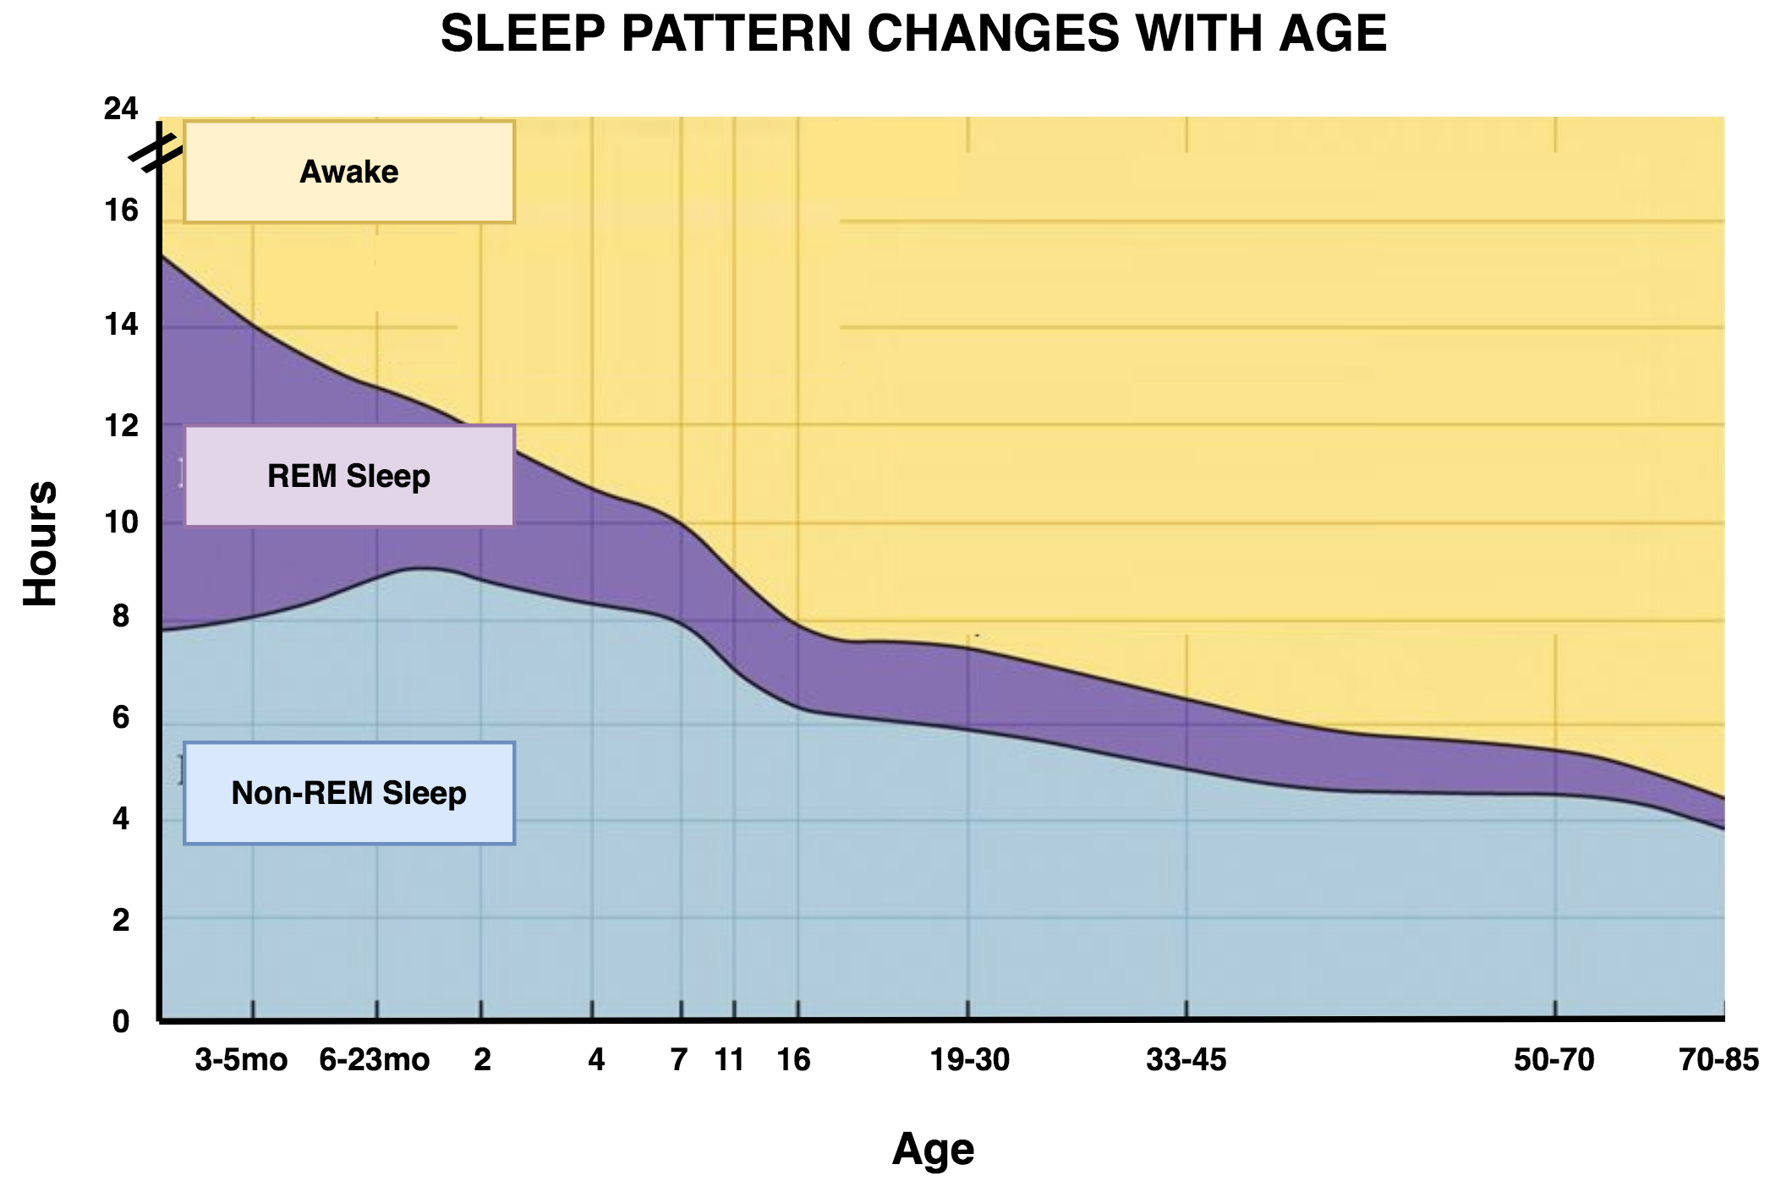

Slide 43
Sleep and the Brain
Reticular Formation
  critical role in sleep and arousal
Neurotransmitters (NT)
  serotonin, norepinephrine, and acetylcholine
  levels vary across sleep stages

Slide 44
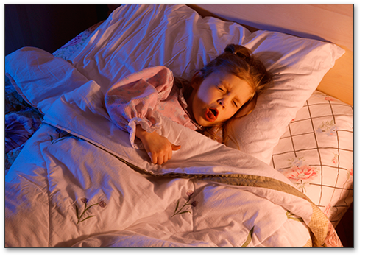
Sleep and Disease
Sleep problems common in diabetes, heart/liver disease, pneumonia.
Infectious diseases induce sleep.
Sleep problems are common in those with mental disorders.

Slide 45
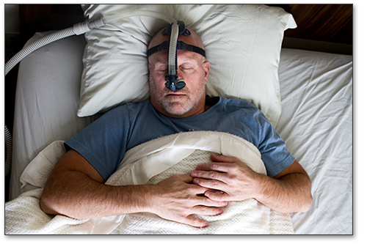
Sleep Disorders (Overview)
Insomnia
Sleep Walking, Talking, and Eating
Nightmares and Night terrors
Narcolepsy
Sleep Apnea

Slide 46
Sleep Disorders (1)
Insomnia == inability to sleep
  Problems falling asleep, waking up too early, waking up in the middle of the night, etc.
Sleeping pills can help, but…
  Stop working after a few weeks
  Long-term use can affect sleep quality
Behavioral changes and practicing good sleeping habits

Slide 47
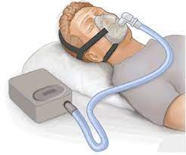
Sleep Disorders (2)
Narcolepsy == sudden, overpowering urge to sleep
  Straight to REM Sleep (skip over N1-N3)
Sleep Apnea == stop breathing during sleep
  Problem w/ windpipe or brain regions controlling respiration
  Approx. 4% of US adults affected
  CPAP machines

Slide 48
Sleep Disorders (3)
Night terrors == sudden arousal from sleep w/ intense fear
  Physiological reactions like rapid heartbeat, loud screaming, etc.
  Occur during slow-wave sleep, most common in children 5-7 years old

Slide 49
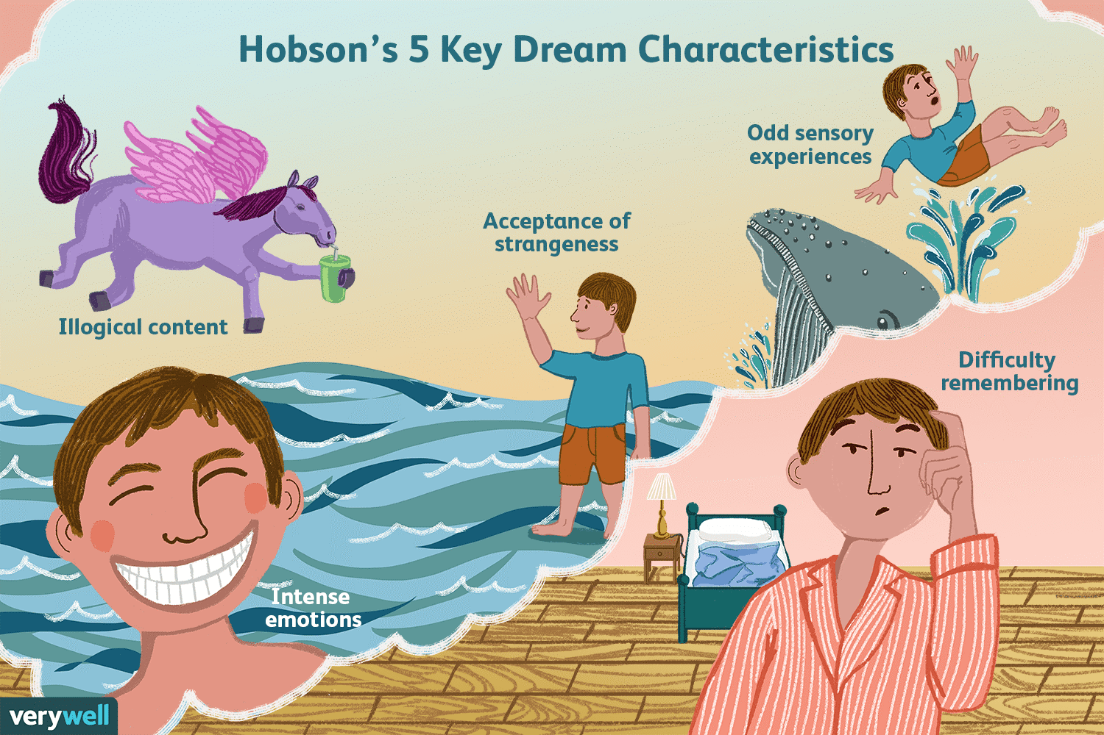

Slide 50
Dreams: Psychodynamic Approach
Freud believed dreams were a “key to the unconscious mind”
Manifest vs. Latent content
  Manifest == what we see in our dreams (could be symbolic)
  Latent == what the dream actually represents
Manifest content expresses a wish in a disguised form
  Analyze dreams to uncover latent meaning

Slide 51
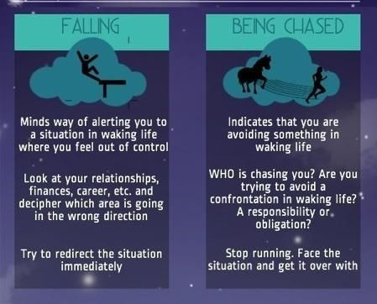
Freud: Interpreting Dreams

Slide 52
Dreams: Cognitive Approach
Dreams can be understood by studying them same way as the waking mind
No search for hidden meaning (Sorry Freud!)
Dreams are a “mental simulation” that is similar to our waking lives

Slide 53

Activation Synthesis Theory of Dreaming
Why does dreaming occur?
  Dreams are the brain’s attempt to make sense of random brain activity during sleep
  External stimuli can be incorporated into dreams
  “Cognitive Trash”

Slide 54
Altered States of Consciousness

Slide 55

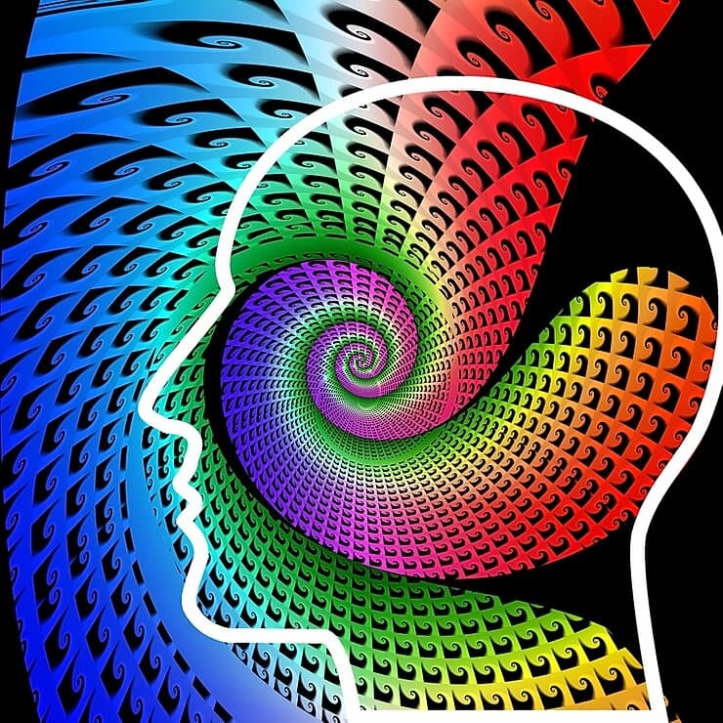
Altered States of Consciousness
Temporary change in one’s normal, mental state
  Not unconscious!!!
Change in awareness
Change can take many forms!
  Hyper-focus, hallucinations, less awareness, etc.

Slide 56
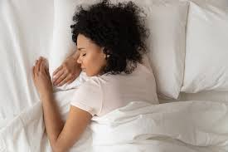
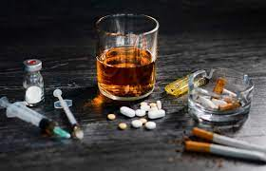

What produces an Altered State?
Sometimes happen naturally
  Example: Sleep
Drug Use
  Alcohol, Marijuana, etc.
Meditation
  Heightened awareness

Slide 57
Class of Drugs
Psychoactive
Depressants
Stimulants
Hallucinogens

Slide 58
Psychoactive Drugs
Act on the nervous system
  Alter consciousness, perception, and/or mood
  Can be recreational or for coping
Tolerance == increased dosage to get the same effect
Frequent use can lead to dependence
  Psychological or physical

Slide 59
Dependance and Addiction
Physical dependance == physiological need for a drug
  Side effects like physical pain and/or craving for drug
Psychological dependance == strong desire to repeat use of a drug (emotional reasons like positive feelings and/or stress reduction

Slide 60

Psychoactive Drugs: Depressants (1)
Slow down mental and physical activity

Slide 61
Psychoactive Drugs: Depressants (2)
Alcohol
  Slows down inhibition & judgment areas of brain
    Increases GABA
  Overdose can lead to sleep, coma, death
  Linked to violence/aggression/irresponsible behaviors

Slide 62
When is Alcohol a Problem?
Binge Drinking == five or more drinks in one sitting
  Decreases w/ age and increasing responsibility
Alcoholism == disorder involving long term, repeated, uncontrolled use of alcohol
1 in 9 individuals who drink are at risk of developing alcoholism. Why?
  Genetic predisposition?
  Environmental influences

Slide 63
Psychoactive Drugs: Depressants (3)
Barbiturates
  Makes sleepy
  Can lead to memory loss, impaired functioning, death
  Highly addictive, risk of seizure with abrupt withdrawal
  Medical use has been replace by tranquilizers
  Do not mix with alcohol!

Slide 64
Psychoactive Drugs: Depressants (4)
Tranquilizers
  Valium / Xanax
  Reduce anxiety, induce relaxation
  Can lead to drowsiness, confusion
  Highly addictive

Slide 65
Psychoactive Drugs: Depressants (5)
Opioids
  Narcotics (Opium / Heroine / Morphine / Methodone)
  Pain killer
    Act on endorphin receptors
  Can lead to euphoria, increased appetites, death
  Highly addictive, painful withdrawal

Slide 66
How do Opioids Work?
Bind to synapses that use endorphins as neurotransmitters
  Individual feels euphoric and pain free
  Increased appetite and sex-drive
After leaving the system, these synapses are under stimulated
  Leads to powerful withdrawal symptoms
  Highly addictive

Slide 67
Psychoactive Drugs: Stimulants (1)
Increase CNS Activity
Caffeine
  Most widely used psychoactive drug
  Everywhere! Coffee, Tea, Certain Soft Drinks, Energy Drinks, Chocolate
  Withdrawal symptoms: apathy, concentration difficulties, headaches, irritability

Slide 68
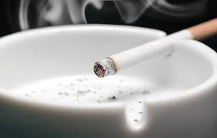
Psychoactive Drugs: Stimulants (2)
Nicotine
  Tobacco
  Enormous health risks
  Alleviates anger/anxiety/pain, can improve alertness
  Withdrawal symptoms include irritability, appetite, distraction

Slide 69
Psychoactive Drugs: Stimulants (3)
Cocaine
  Half hour rush followed by agitation/depression
Amphetamines
  Used to boost energy, stay awake, curb appetite, ADHD
  Crystal Meth: Intense high; huge come-down

Slide 70
Psychoactive Drugs: Stimulants (4)
MDMA (Ecstasy)
  Also halucinogenic
  Users tend to feel warm bonds with others
    Increased sexual risk-taking
  Releases serotonin, dopamine, norepinephrine
  Impairs memory and cognition

Slide 71
Psychoactive Drugs: Hallucinogens
Hallucinogens Modify our Perceptual Experiences
Marijuana
  Affects anandamide receptors, widely distributed in the brain
  Mixture of psychological effects: Hard to classify
  Affects mood, appetite, blood pressure.
  Smoking can damage lungs
  Medical uses: AIDS, cancer, pain.
LSD (lysergic acid diethylamide)
  Visual hallucinations. Time perception prolonged
  Pleasurable or grotesque/horrific
  Primarily acts on serotonin
  Can result in mood swings, impaired attention/memory

Slide 72
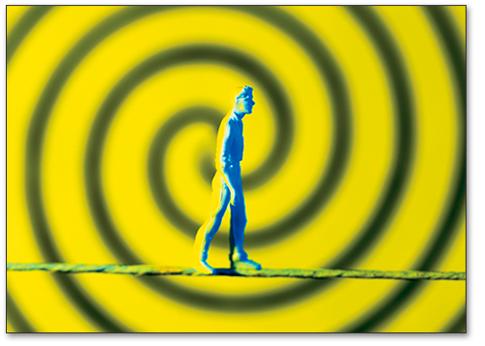
Other Altered States: Hypnosis (1)
Hypnosis is marked by…
  altered attention and expectation
  unusual receptiveness to suggestions
Notes:
Note: What exactly hypnosis is, is hard to pinpoint and also highly controversial.

Slide 73
Other Altered States: Hypnosis (2)
Minimize Distractions
Guided Concentration
Set Expectations
Suggest States

Slide 74

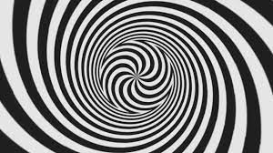
Explaining Hypnosis (1)
Early Psychologists: Divided state of consciousness
  This account states that hypnosis involves splitting consciousness in two
    Observer and actor
  Each half is not aware of the role played by the other
    Higher level consciousness not aware of our actions in this state

Slide 75
Explaining Hypnosis (2)
Social Cognitive Behavior view
  Not an altered state of consciousness
  Combination of social pressures (social), heightened attention (cognitive), and person acting how they think a hypnotized person should act (behavior)

Slide 76
Uses of Hypnosis
Hypnosis is used to…
  treat various health issues
    alcoholism
    smoking
    Somnambulism (Sleep Walking)
    PTSD
  Is it effective?
    debatable
    Can potentially reduce experience of pain.
Notes:
Note: The efficacy of hypnosis in reducing pain and enhancing immune responses is well attested. The long-term utility of hypnosis for treating addictions is more controversial.

Slide 77

Meditation
A peaceful state of mind, not occupied by worry
Mindfulness meditation used to treat a variety of conditions
  Examples: depression, stress, chronic pain
Notes:
Suggestion: Instructor could note the strategic similarity of meditation in treating disorders to cognitive therapy, to Lamaze birthing techniques and to self-hypnosis.

Slide 78
Consciousness and Health
Mindfulness meditation
  Meditation == peaceful state of mind where thoughts are not occupied by worry
  Mindfulness == Being in tune w/ one’s body/surroundings

Slide 79
Benefits of Mindfulness Meditation
Reduction in depression, stress, and anxiety
Pain management
Fewer negative emotions
Benefits memory/attention

